Slide 1

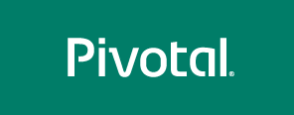
PCF architecture and operations
Notes:
test
afdas

Slide 2

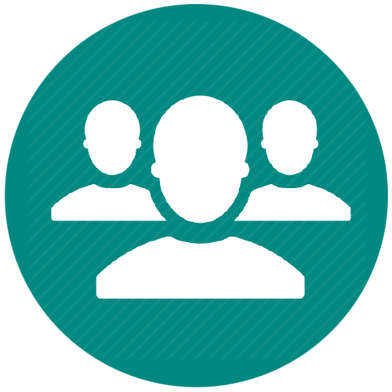


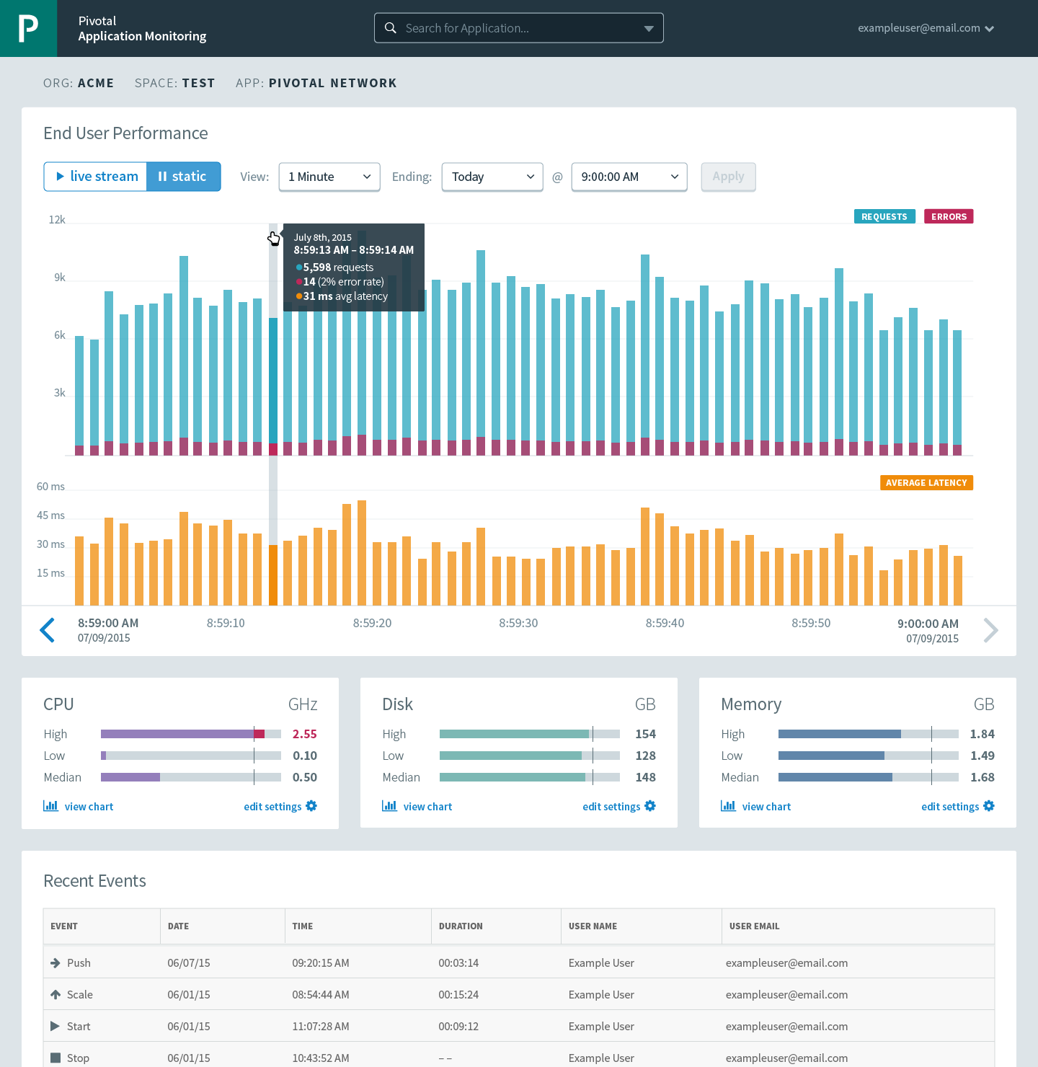



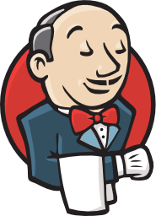

Cloud Foundry: An Application-centric Platform
Mobile Services
Centralized Log Management
Networking
& Load Balancing
Auto-Scaling
APM & Tracing
APPLICATION
Health management
Full Stack CI/CD platform
Notes:
Your Application is the Center of the universe!
Cloud Foundry takes care of the rest. Everything you need to deliver software is builit into this platform such as…. It changes the way applications and services are deployed and run by reducing the develop to deployment cycle time. And Devops culture enables the overall ownership there for allows teams to do what’s best for the applications, and therefore what’s best for the business, so not only your application is more robust, it can constantly adapts to changing environmental.
So Spring Boot/Cloud meant create apps fast – But Dev & Ops is asking Day2 questions -
How do you do logging, routing, apm, scaling, and lifecycle management of all these apps.
Enter CF Runtime
best in class container management
integrated agentless logging
with APM
auto scaling
Effortless runtime with minimum human operational overhead. We run 1000s of apps and 10,000s containers on PWS with 6 guys.
But we realized that stopping there wasn't enough

Slide 3



Cloud Foundry Haiku
Here is my source code
Run it on the cloud for me
I do not care how
Notes:
Best way to summarize cloud foundary experience for developers. Here is the famous CFH.
a Japanese poem of seventeen syllables, in three lines of five, seven, and five

Slide 4
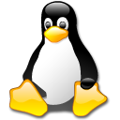





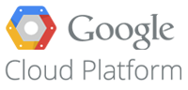

Pivotal CF Architecture
Login Server
OAuth 2.0 Server (UAA)
Blobstore
Ops Manager UI
Cloud Controller
CC Bridge
BBS
Ops Manager Director
Operations Manager
CELL
CELL
etcd
Service Broker
Rep
Exec.
Rep
Exec.
Dynamic Router
Brain
Service Nodes
HA Load Balancer
Garden
.NET
Auctioneer
Service
Converger
Metron Agent
Metron Agent
Service Broker
Access
Loggregator
Service Nodes
Traffic Controller
SSH Proxy
Service
Doppler
Log Firehose
Fileserver
BOSH
Azure
Notes:
(Software is hard.) Developers, rejoice! All you need is I to write an app and push it. The whole point of Cloud Foundry is really to make your life as the developer exceedingly simple. But we know that in general, writing software is hard and so we had to take that hard and put it somewhere and we put it inside of Cloud Foundry so that you as a developer don’t have to worry about it. But so because we place that hard somewhere, we got this complicated beast. It does a pretty good job in doing the right things so developers have the faith not have to worry about any infrastructure.
The pivotal cloud foundary architecture is quite large and can be overwelming. Everybox here is a VM including bosh here.
It is a Microservice design. It has over 20 VMs . While each VM
it has ~20 VMs in addition to the existing three VMs: nats, Bosh light, ops manager. Now there is Router vm, blog store, oauth, uaa, database They all do something. They all do one thing and they do it very well. There is not much dicisions to make. It is kind of brutal force, very very effience. All of these sit on top of iaas, and bosh is managing all these.
Of course it is infrastructure unaware and iis it doesn't matter what your underlying infrastructural is, it could be ____aws,___vmware VSphere, it walks consistently across the different infrastructures. So you are experienced, when you are running Cloud Foundry on a __particular provider__________________ across the others.
And the Elastic Runtime Architecture is quite large and certainly I don’t expect you to understand all of it and so we’re not gonna go into a whole lot of detail only just kind of broad strokes here. But it’s easiest if we break it down into sub systems so were run through all of these. And then we’ll go through some key sequences to help us understand how these all comes together. And we’re gonna take an inside-out approach in a minute.
Diego, the first sub system within Elastic Runtime. It’s a scheduler. It’s responsible for scheduling tasks and long processeses.
A diego Task is an application that’s guaranteed to run at most once. That’s not something that we expose via the CF and CLI today, but we do use it within the platform, within the Pivotal Cloud Foundry. A good example of that is staging an application. So despite how many instances you have of a web app for instance, it only needs to be stage one time.
A Long-running Process on the other hand is typically, represented as a web app and you can have many instances of the long running processes.
The tasks and long-running processes are ran within a Container. And that container is imitable, just like we‘ve been talking about imitable infrastructure, once that container gets created it’s not going to change. There’s not gonna be changes made to it. And your applications are running safely within that, gives you that isolation in terms of CPU memory and disk.
And that allows you to have really nice application density on an operating system. In Pivotal Cloud Foundry’s case, that would be a cell. Pivotal Cloud Foundry has a pool of cells. Many, many VMs are of types cell and your application instances gets distributed across cells.
So what manages all of these Containers. Well, something known as Garden. And Garden is an interface with many different back-ends. And the reason that as many different back-ends is that so that it can support many different types of platforms.
For example, It has a Linux backend and a Windows backend. So you can run windows based applications and applications that can run on Linux as well. And it all has the same interface.
Rep is a part of process that’s running on the cell as well and it represents the cell and the bulletin board system, which we will talk about in a moment.
But also an Auction. An Auction is just like it sounds, it’s essentially held to bid on executing a task or long running process.
The Executor is the sub process of the Rep and one of its responsible for .. is really kind of understanding with what’s going on with that cell in terms of half container allocations. So it doesn’t have enough memory to allocate another container to this given cell. If it doesn’t it wouldn’t participate in an auction for instance.
Additionally, the Executor does for Loggs on to Metron which subsequently _______ them to Loggreators. So Loggreator, excuse me Metron is of course also living in the cell and so you begin to see the beginnings of a micro service based architecture here.
Bulletin Board System (BBS) is the API to the Diego database. It understands what's going on in terms of tasks and long-running processes and it persists all of these information into the etcd.
The Brain is really responsible for holding the Auction and it does that through sub process known as the Auctioneer. The Converger is also important but I'm going to save the conversation on that until we talk about that in the high availability section.
Next we have the Loggregator. Loggregator is all about Logs and we had talked about how Metron is living on the cell and it passes logging information onto the Loggregator subsystem.
The subsystem is made up of a lot of different components one of which is called Doppler. So one of the capabilities of the system is the ability to create what are known as App Syslog Drains, and what that allows you to do is drain all of your logs to a third-party log management system such as Splunk or Papertrail.
And then of course there's also the Traffic Controller. The Traffic Controller is another component but it's responsible for essentially handling requests such as CF logs. You guys will do that in the lab, We’ll do CF log statement and actually get to see all the logs from your application and various parts of the platform as it relates to your application.
Additionally there are other ways to plug in to the Loggregator system. We've exposed what's known as the Firehose which is a websocket endpoint, that exposes a lot of things and that's why it's called the Firehose, the app logs, container metrics and elastic runtime component metrics.
And really... what we're seeing folks do with this is, is pipe it into what are known as Nozzles. You to create a Nozzle and then transform it into whatever format you need it to. So for instance the Datadog Nozzle, you could create a nice visualization and Datadog to understand what's going on with your Pivotal Clou Foundry Instance.
The Cloud Controller Cloud Controller is very important part of the system. It exposes the API for using and managing the Elastic Runtime. The _____________ responding to the push request. It allows you to deploy your applications, and overall manage the system.
The Cloud Controller persists a lot of its information and what's known as a Cloud Controller Database. This has information about your Orgs, your Spaces and your App data. App data meaning, your application name, your memory, any environment variables you might set, those types of things.
The Blob Store is also important piece, so when you do an upload you actually save the the application artifact to the Blob Store but when you also go through staging and create the droplet that also gets saved to the to the Blob Store, and it's really just kind of a way to optimize the system so that those tasks don't have to be done over and over again.
When we talk about the Cloud Controller Bridges, will become more apparent the next slide, but really what the Cloud Controller Bridge is all about, is really translating an application specific domain into the more generic Diego language of tasks and long-running processes.
So let's talk a little bit about Routing. In this case, the Router is responsible for routing traffic to the appropriate component it's not much of a surprise. So for instance whatever your URL is, it's going to be able to map that to various application instances running on the given cells.

Slide 5
Pivotal Cloud Foundry
Platform Access
Ops Manager
Elastic Container Runtime
Service
Dynamic Router
Service
Logging / Metrics
Application
Access
BOSH - Automation Layer
Azure

Slide 6


CF PUSH Demo
Notes:
Push an App, show the logs

Slide 7

Pushing an Application
Platform Runtime (Elastic Runtime)
Blobstore
Service
credentials
Upload app bits and metadata
DB
push app
+ app MD
Cloud Controller
Service Broker Node(s)
Create and bind services
Stage application
Deploy application
Manage application health
Router
Container Management - DIEGO
Cell
DEA
Brain
DEA
DEA
+
=
Notes:
Talk and click through how applications are deployed and all of the manual effort that is automated underneath the hood.
Cloud Foundry PaaS – Pushing an Application with Diego
App deployment: what has changed?
1- Domain specific (notion of apps) -> Abstractions (notions of LRPs and Tasks). App staging is a Task. App start is launching a LRP.
2- Platform specific (Linux) -> Supporting multi platform (Windows & Linux) enabling running also .NET apps, thanks to our new Container implementation: Garden
What’s more, there is a 3rd workflow supported: Docker on Linux
3- New Auction-based workload scheduler: Cloud Controller no longer in charge of deciding where AIs are spun up. Auctioneer manages the process running an auction, making it more optimized.
With Diego in place, more loosely-coupled components take part in the process, stripping down the Cloud Controller from too many previous responsibilities, making it easier to maintain and evolve the entire architecture.
The Cloud Controller handles the routing of client requests internally through the Cloud Controller Bridge. It also manages the Blobstore to store packages and droplets and the DB to store App Metadata and Service credentials. Blobstore could be internal or external, depending on the setup.
A service gateway provides an interface for services (native or external).
More in the next slide about the Cloud Controller Bridge (CC-Bridge), the Bulletin Board System (BBS) and the Auctioneer in the next slide
Apps run in a CELL, part of the new Cloud Foundry Runtime, called Diego
Routers manage application traffic.
Diego handles all health management for apps (now LRPs), through a series of single-purpose components: Nsync (part of the CC-Bridge), BBS (part of Diego DB) and the Converger (part of the Diego Brain)
Apps are accessed directly through the router while web and CLI clients (e.g., vmc, STS) access Cloud Controller via RESTful services.

Slide 8
Staging and Buildpacks
Buildpacks are responsible for preparing the machine image for an application.
}
Application
Buildpack
Container
Libraries
Droplet
CELL
Runtime
Operating System

Slide 9
Buildpack Flavors
Buildpacks installed into a Cloud Foundry instance or loaded from an external location at app deployment time
Buildpacks provided by public Cloud Foundry
Modify existing buildpacks or write your own
Java
Ruby
Node.js
Binary
Go
Python
PHP
Staticfile
.NET
.NET Core
Notes:
Java
Ruby
Node.js
Custom Build packs

Slide 10
Customize the Container Experience
Developer brings customized app
Platform buildpacks bring standard runtime*
App
Container
Platform provides fixed OS container image
Platform provides fixed host OS Kernel
* Devs may bring a custom buildpack

Slide 11
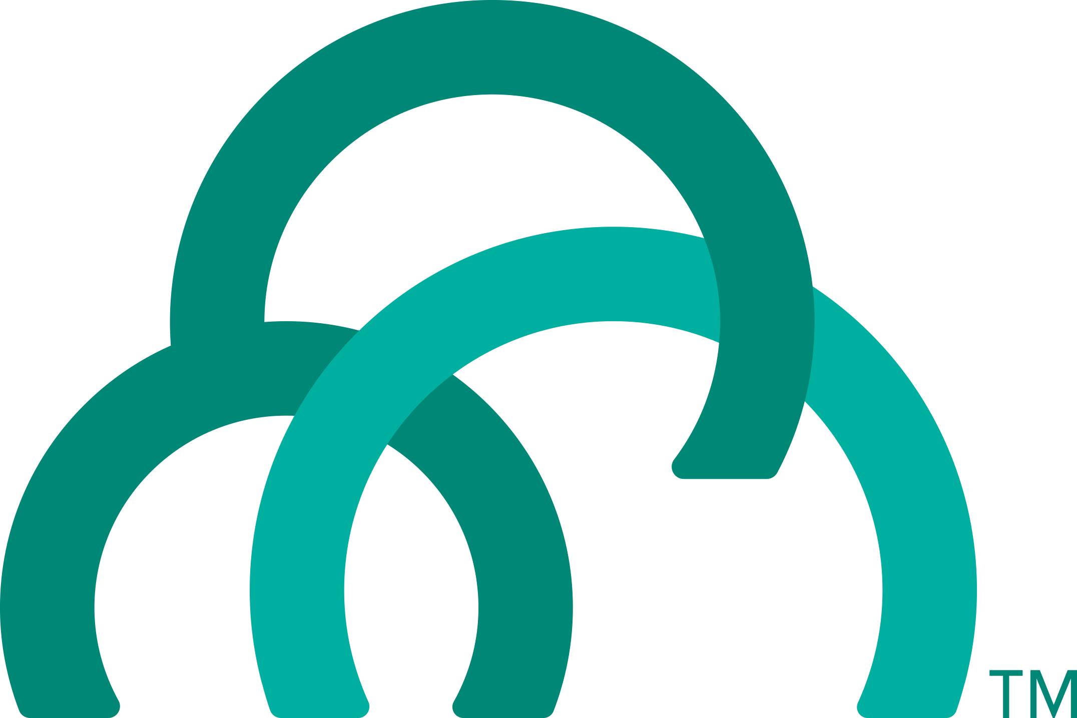
Application Containers and Scaling
LRP
Deploy Request
LRP
Scale Request
Blobstore
Cloud Controller
Cloud Controller Bridge
BBS / etcd
Access App
Service
credentials
CELL Auction
Brain
DB
Auctioneer
Router
Converger
CELL
CELL
CELL
Desired
Actual
Executor
Rep
Executor
Rep
Executor
Rep
Runtime

Slide 12
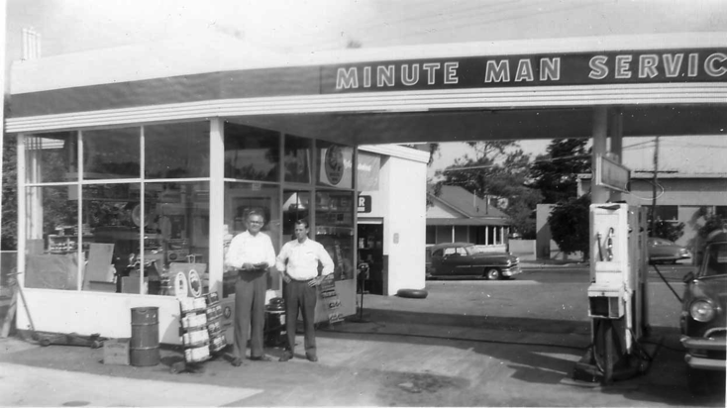
What is a Service
Allows resources to be easily provisioned on-demand
Typically middleware, frameworks, and other “components” necessary for applications
Can be a persistent, stateful layer

Slide 13
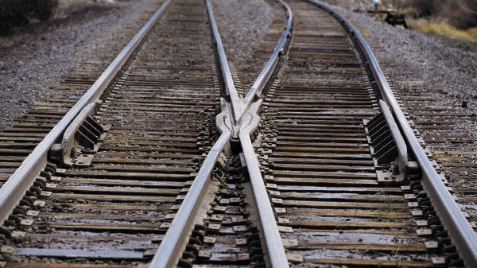
Two Types of Services
Managed - Fully integrated, with full lifecycle management
User-Provided – Created and managed external to the platform

Slide 14
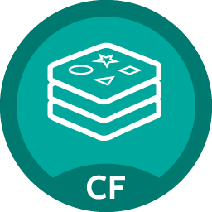
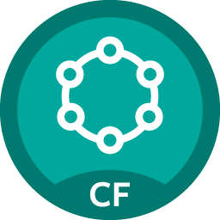
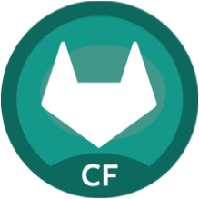
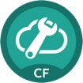
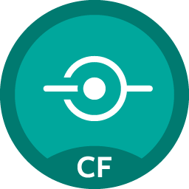
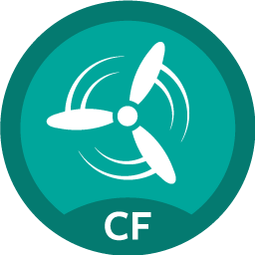
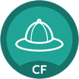
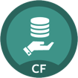
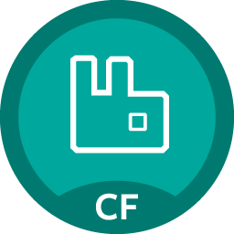
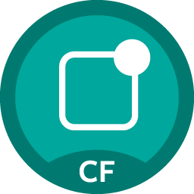
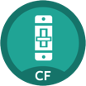
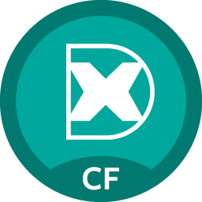
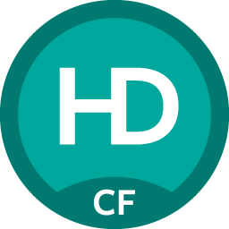
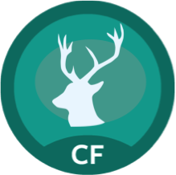

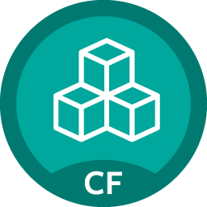

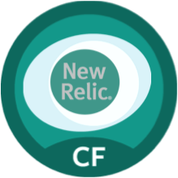
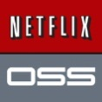
Pivotal Cloud Foundry Services
Mobile
Data
CI/CD
Cloud Native
Redis
DataStax Cassandra
Git Lab
Config Server
App
Distribution
Concourse
Service Directory
Push Notifications
MySQL
RabbitMQ
Monitoring
Circuit Breaker
Security
Data Flow
PivotalHD
App Dynamics
Single Sign-on
Session state caching
GemFire
Powered by
New Relic

Slide 15
Self provisioning - Creating and Binding a Service
Service
credentials
DB
CLI
create service (HTTP)
Cloud Controller
create service (HTTP)
Service
Broker
reserve resources
Data
Service
Router
bind service (HTTP)
bind service (HTTP)
obtain connection data
Pivotal Cloud Foundry
Elastic Runtime
Notes:
An application runs in a DEA, which is a droplet execution agent. The Cloud Controller orchestrates the routing and lifecycle of all DEAs in the pool. Routers manage application traffic. Health Manager reports mismatched application states to the CC. A service gateway provides an interface for services (native or external). A messaging bus manages all system communication. Apps are accessed directly through the router while web and CLI clients (e.g., vmc, STS) access Cloud Controller via RESTful services.

Slide 16
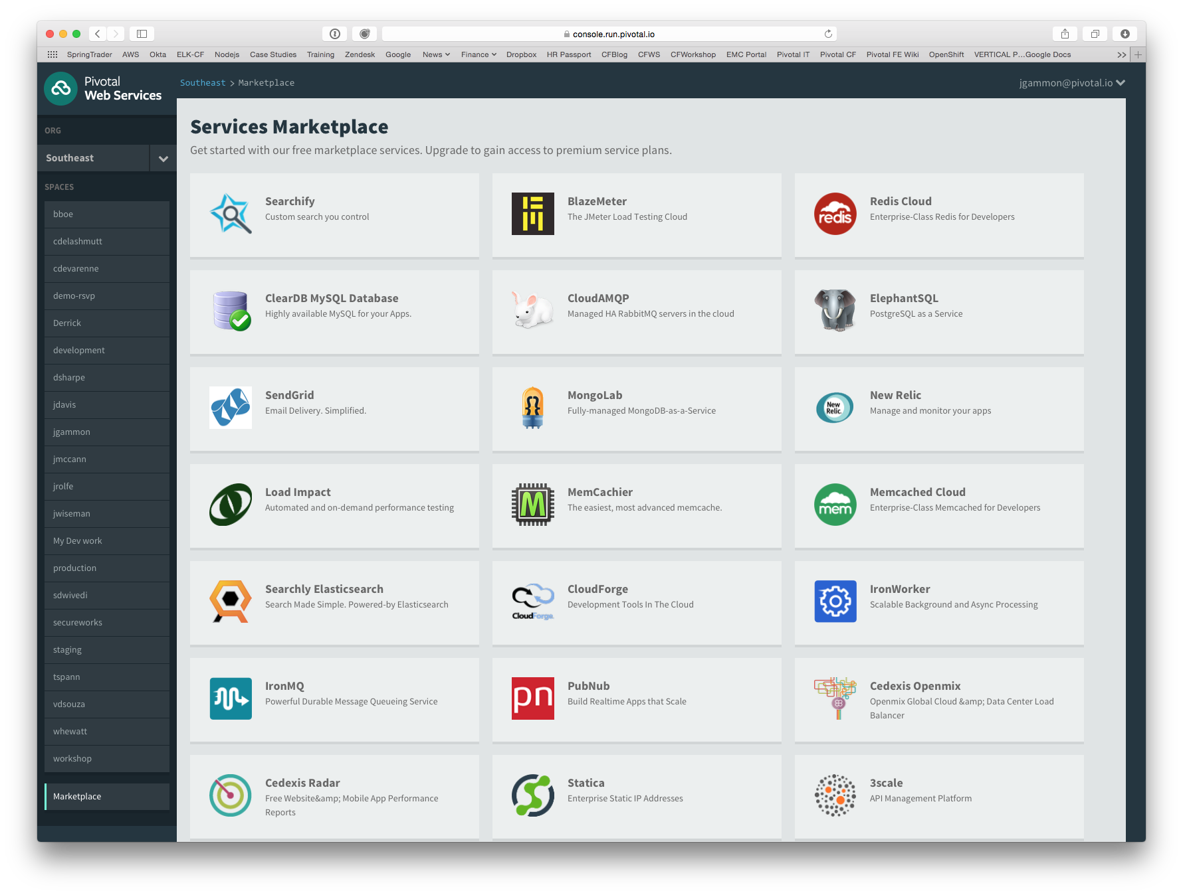
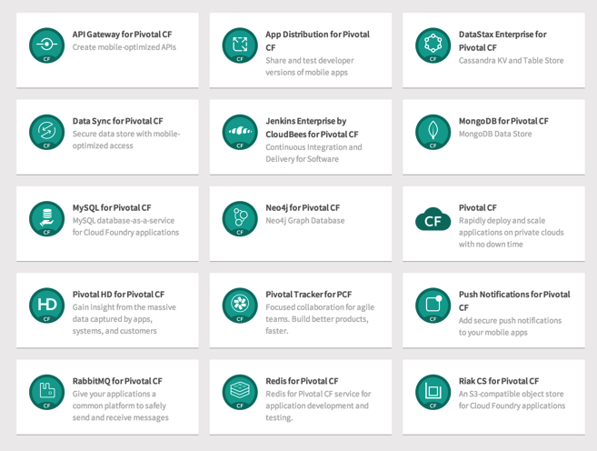
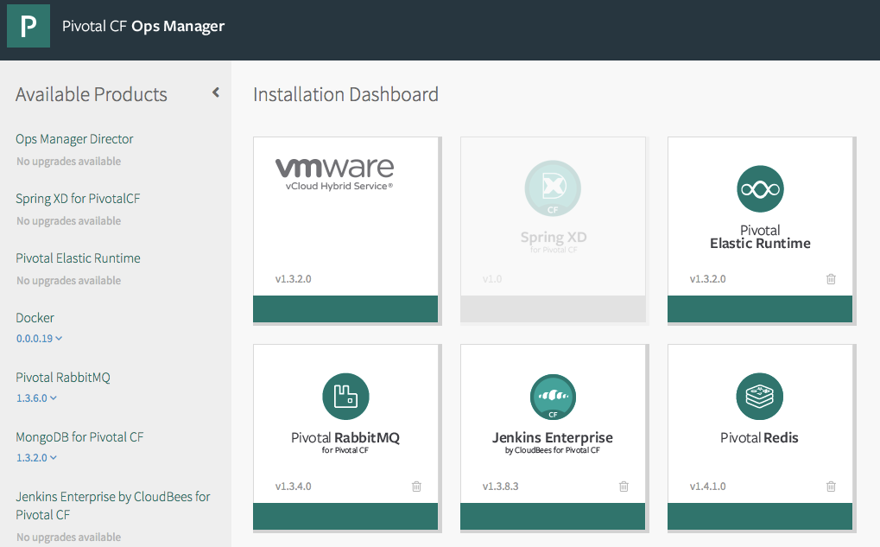
PCF Marketplace
Broad Services Ecosystem
Easy accessibility
Quick, self-provisioning

Slide 17

Four Layers of High Availability – Built In
Application Instance
Platform Processes
Platform VMs
Availability Zones

Slide 18
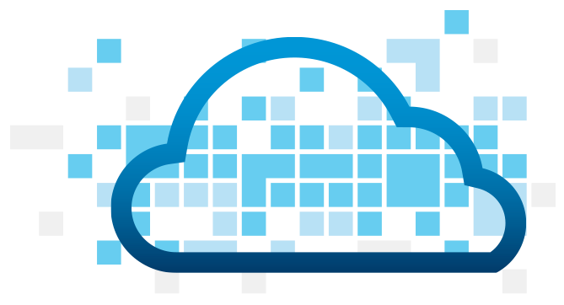
Application Instance HA
Blobstore
Cloud Controller
DB
Service
credentials
creds
Cloud Controller Bridge
Actual State
Desired State
Actual State
Re-deploy App
BBS
Converger & Auctioneer
Router
CELL
CELL
CELL
Exec.
Rep
Exec.
Rep
Exec.
Rep
Runtime

Slide 19

Platform Process HA
BBS
AGENT
Restart!
Health Monitor
Responses:
Cell
pager
AGENT
pager
Message Bus
email
email
monitoring
monitoring
…
…
Cloud Controller
AGENT
Pivotal CF Operations Manager
IaaS
Notes:
Two processed on the VMs are MONIT and BOSH agent
Monit monitors the actual state of processes, while BOSH agent is used to communicate the status to the health monitor
In a process goes down, Monit tries to restart it
If successful, or not, BOSH agent is notified, who then tell Health monitor, which will notify the operator
The processes running on the virtual machines (i.e. the health manager) are started with monit, an opensource linux utility that keeps an eye on processes and will respond when one dies. If a process dies then, monit will do two things: first, it will try to restart the process and second, whether the restart is successful or not, it will tell the BOSH agent about the failure. Recall that the Bosh agent is there to communicate with Operations Manager and in this case it will relay this failure information to the Operations Manager Health Monitor (not to be confused with the Health Manager of the elastic runtime that was discussed above) – we’ll abbreviate it OMHM. The OMHM will take this alert and pass it through a list of responders that can be configured to do things like send emails, page administrators and display alerts in operations dashboards. There’s a good chance that monit will already have recovered the process, but we also want there to be an opportunity for a human to respond.

Slide 20

Platform Virtual Machine HA
Cloud Controller
DB
Agent
Process
BOSH Director
Health Manager
Blobstore
Agent
Process
Re-create VM
Ressurector
BBS
VM is
missing…
Agent
Process
Message Bus
Health
Monitor
Cloud Controller
Agent
Process
Pivotal CF Operations Manager
IaaS

Slide 21
Availability Zone HA
Zone 1
Zone 2
System components and Application instances are evenly distributed over two availability zones.
Cell
Cell
Cell
Cell
Router
Cell
Cell
Runtime
Notes:
Zone could = rack, for example

Slide 22
Pivotal Enables Four Levels of HA
1.
2.
3.
4.
PCF
PCF
PCF
Zone 1
Zone 2
A
B
C
A
B
C
A
B
C
A
B
C
A
B
C
A
B
C
A
B
C
Process
VM1
VM2
VM3
B
B
B
B
3. Resurrector restarts failed VMs
VM1
VM2
B
A
B
C
A
B
C
A
B
C
A
B
C
OS,
Mware
OS,
Mware
OS,
Mware
B
B
B
B
If an app fails, PCF reboots app in a new container.
If a process fails, PCF restarts the process
If an OS or network failure occurs PCF kills the VM and reboots the host in a new Virtual machine.
If a datacenter rack fails, PCF ensures applications stay running in multiple availability zones
App Fail
Process Fail
VM Fail
Rack Fail
Notes:
Application performance and reliability have a direct correlation to HA capability. Pivotal provides 4 level of HA so that you don’t need to invest in people/software to handle common failure situations. If an application fails, we will reboot it in a new container. This automated remediation addresses application bugs that result in outages. If a Pivotal process fails, we will reboot it in a new virtual machine. Our PaaS essentially monitors and remediates itself. If an OS or network failure occurs, our VM monitor will detect this and kill the VM, then reboot it in a new container. This streamlines Linux sysadmin operations. Lastly, if a datacenter rack fails, we will ensure the application stays running because we load application instances in multiple availability zones. No 2 availability zones live on the same datacenter rack. This hardware failure level resilience is very difficult to design using traditional tools provided by HP/CA/IBM.
And, by using Pivotal, you reduce the number of servers that require HP/CA/IBM monitoring tools.
http://blog.pivotal.io/cloud-foundry-pivotal/products/the-four-levels-of-ha-in-pivotal-cf
Desired State of Application is maintained by Cloud Controller. DEAs communicate status of their apps to Health Manager. HM checks with CC. CC restarts app in another DEA in case of failure
PCF Processes monitored by monit and restarted in case of failure
In case of VM failure. Health Monitor is notified. HM calls BOSH Director which calls Resurrector component which starts up the VM (with processes)
Availability Zones is a logical grouping of the deployment of System Components and DEAs. (Example would be two racks in a datacenter)

Slide 23
Zero Downtime
Blue-Green Deployment
myapp.cfapps.io
App Version1
App Version2
Live Traffic
Live Traffic

Slide 24
Platform Upgrades and Patches
BOSH executes Canary-style deployments to minimize downtime
Also known as rolling upgrades
A select number of “canary” VMs from the new release are deployed
BOSH verifies new VMs have been deployed successfully
Remaining VMs are deployed only if the upgrade of canary VMs succeeded
Otherwise the upgrade is halted

Slide 25
Upgrade and patch with rolling “canary” deploys
A
B
M
N
X
Y
A,B,M,N,X,Y
- Application instances
- VM prior to update
Notes:
The other great thing about PCF infrastructure automation isr rolling or canary style zero downtime updates.
[[Ask: Does everyone know about the statement canary in the coal mine? If not, explain what that is]].
Upgrades and patches are introduced to PCF based on the canary model. The application instances are moved off the trial VMs and deployed elsewhere and user traffic is routed there. The patch or upgrade is applied to the now “empty” trial VMs and if that passes, the VM is ready to accept new application instances. The changes are rolled through in batches all the while redeploying applications and seamlessly rerouting traffic to available instances until the system is returned to consistency with the update fully applied. Our infrastructure automation layer gives operators ability to update the operating system that’s embedded into platform.

Slide 26
Upgrade and patch with rolling “canary” deploys
A
B
M
N
X
Y
A
B
M
X
N
Y
Apps redeployed to clear VMs
Notes:
The other great thing about PCF infrastructure automation isr rolling or canary style zero downtime updates.
[[Ask: Does everyone know about the statement canary in the coal mine? If not, explain what that is]].
Upgrades and patches are introduced to PCF based on the canary model. The application instances are moved off the trial VMs and deployed elsewhere and user traffic is routed there. The patch or upgrade is applied to the now “empty” trial VMs and if that passes, the VM is ready to accept new application instances. The changes are rolled through in batches all the while redeploying applications and seamlessly rerouting traffic to available instances until the system is returned to consistency with the update fully applied. Our infrastructure automation layer gives operators ability to update the operating system that’s embedded into platform.

Slide 27
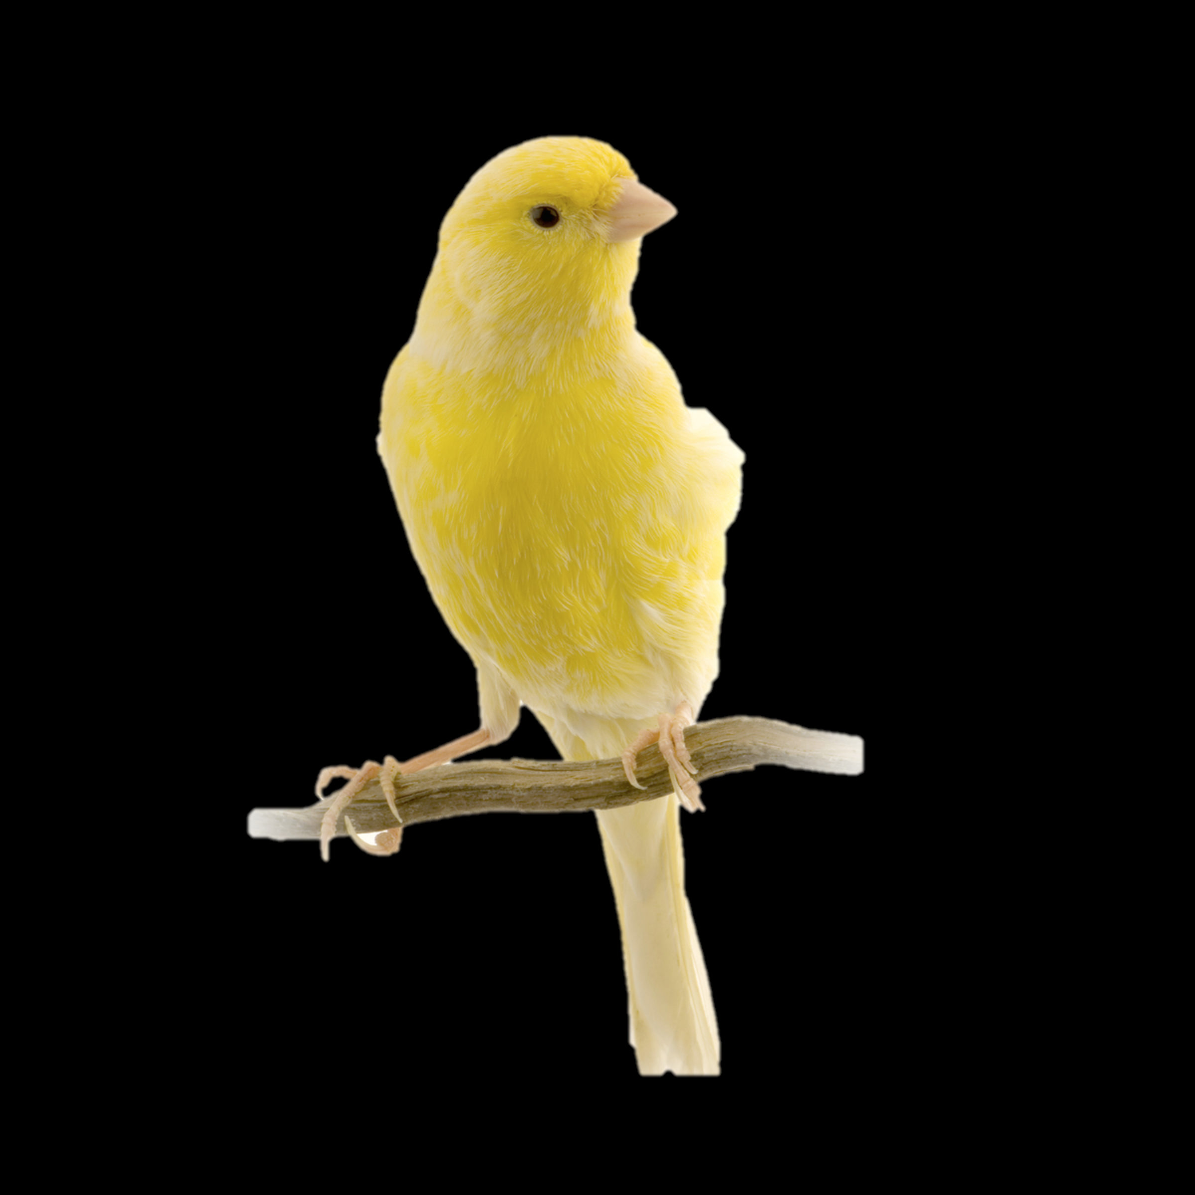
Upgrade and patch with rolling “canary” deploys
A
B
M
N
X
Y
A
B
M
X
N
Y
A
B
M
X
N
Y
Update introduced. If the tests pass, keep going
Notes:
The other great thing about PCF infrastructure automation isr rolling or canary style zero downtime updates.
[[Ask: Does everyone know about the statement canary in the coal mine? If not, explain what that is]].
Upgrades and patches are introduced to PCF based on the canary model. The application instances are moved off the trial VMs and deployed elsewhere and user traffic is routed there. The patch or upgrade is applied to the now “empty” trial VMs and if that passes, the VM is ready to accept new application instances. The changes are rolled through in batches all the while redeploying applications and seamlessly rerouting traffic to available instances until the system is returned to consistency with the update fully applied. Our infrastructure automation layer gives operators ability to update the operating system that’s embedded into platform.

Slide 28

Upgrade and patch with rolling “canary” deploys
A
B
M
N
X
Y
A
B
M
X
N
Y
A
B
M
X
N
Y
Apps redeployed to updated VMs
A
B
M
X
N
Y
Notes:
The other great thing about PCF infrastructure automation isr rolling or canary style zero downtime updates.
[[Ask: Does everyone know about the statement canary in the coal mine? If not, explain what that is]].
Upgrades and patches are introduced to PCF based on the canary model. The application instances are moved off the trial VMs and deployed elsewhere and user traffic is routed there. The patch or upgrade is applied to the now “empty” trial VMs and if that passes, the VM is ready to accept new application instances. The changes are rolled through in batches all the while redeploying applications and seamlessly rerouting traffic to available instances until the system is returned to consistency with the update fully applied. Our infrastructure automation layer gives operators ability to update the operating system that’s embedded into platform.

Slide 29
Upgrade and patch with rolling “canary” deploys
A
B
M
N
X
Y
A
B
M
X
N
Y
A
B
M
X
N
Y
A
B
M
X
N
Y
A
B
M
X
N
Y
Remaining VMs updated same way
Notes:
The other great thing about PCF infrastructure automation isr rolling or canary style zero downtime updates.
[[Ask: Does everyone know about the statement canary in the coal mine? If not, explain what that is]].
Upgrades and patches are introduced to PCF based on the canary model. The application instances are moved off the trial VMs and deployed elsewhere and user traffic is routed there. The patch or upgrade is applied to the now “empty” trial VMs and if that passes, the VM is ready to accept new application instances. The changes are rolled through in batches all the while redeploying applications and seamlessly rerouting traffic to available instances until the system is returned to consistency with the update fully applied. Our infrastructure automation layer gives operators ability to update the operating system that’s embedded into platform.

Slide 30
Upgrade and patch with rolling “canary” deploys
A
B
M
N
X
Y
A
B
M
X
N
Y
A
B
M
X
N
Y
A
B
M
X
N
Y
A
B
M
X
N
Y
A
B
M
X
N
Y
Automated, No downtime
Atomic rolling update
Notes:
The other great thing about PCF infrastructure automation isr rolling or canary style zero downtime updates.
[[Ask: Does everyone know about the statement canary in the coal mine? If not, explain what that is]].
Upgrades and patches are introduced to PCF based on the canary model. The application instances are moved off the trial VMs and deployed elsewhere and user traffic is routed there. The patch or upgrade is applied to the now “empty” trial VMs and if that passes, the VM is ready to accept new application instances. The changes are rolled through in batches all the while redeploying applications and seamlessly rerouting traffic to available instances until the system is returned to consistency with the update fully applied. Our infrastructure automation layer gives operators ability to update the operating system that’s embedded into platform.

Slide 31

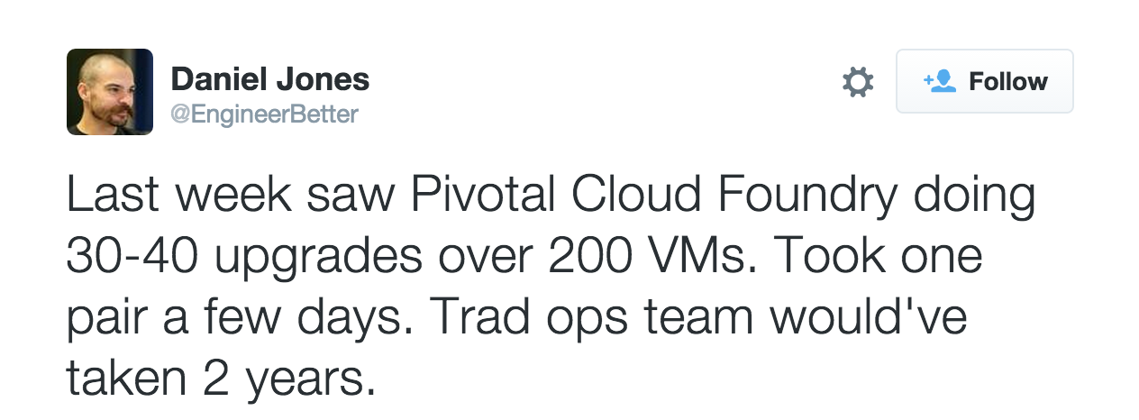

Upgrade and patch with rolling “canary” deploys
Notes:
This comes in pretty handy because lately it seems like we’re getting hit with so many CVE’s. When heartbleed virus hit, our customers took our patch and using canary deploys the fix ran itself across all the VMs under PCF in the data center. All they used was our GUI and 2 easy commands.
Talk track covers how its manual w/ Docker.

Slide 32
3 Rs to address top 3 security threats
Repair
Rotate
Repave

Slide 33
Logging
Different levels of logs:
Application logs
Platform logs
Three ways of getting app logs
Apps manager
Cf logs
Drain application logs, e.g. syslog drain

Slide 34
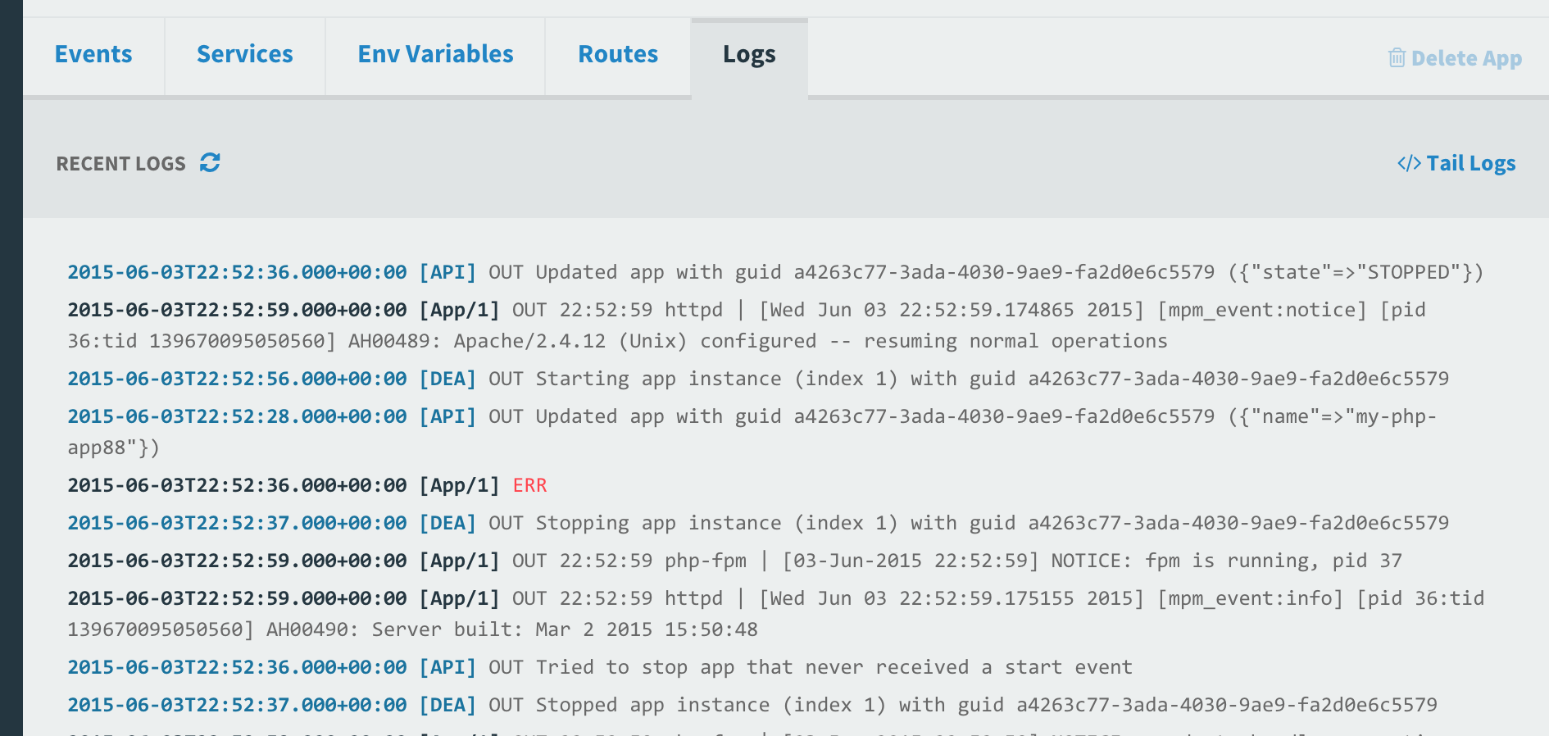
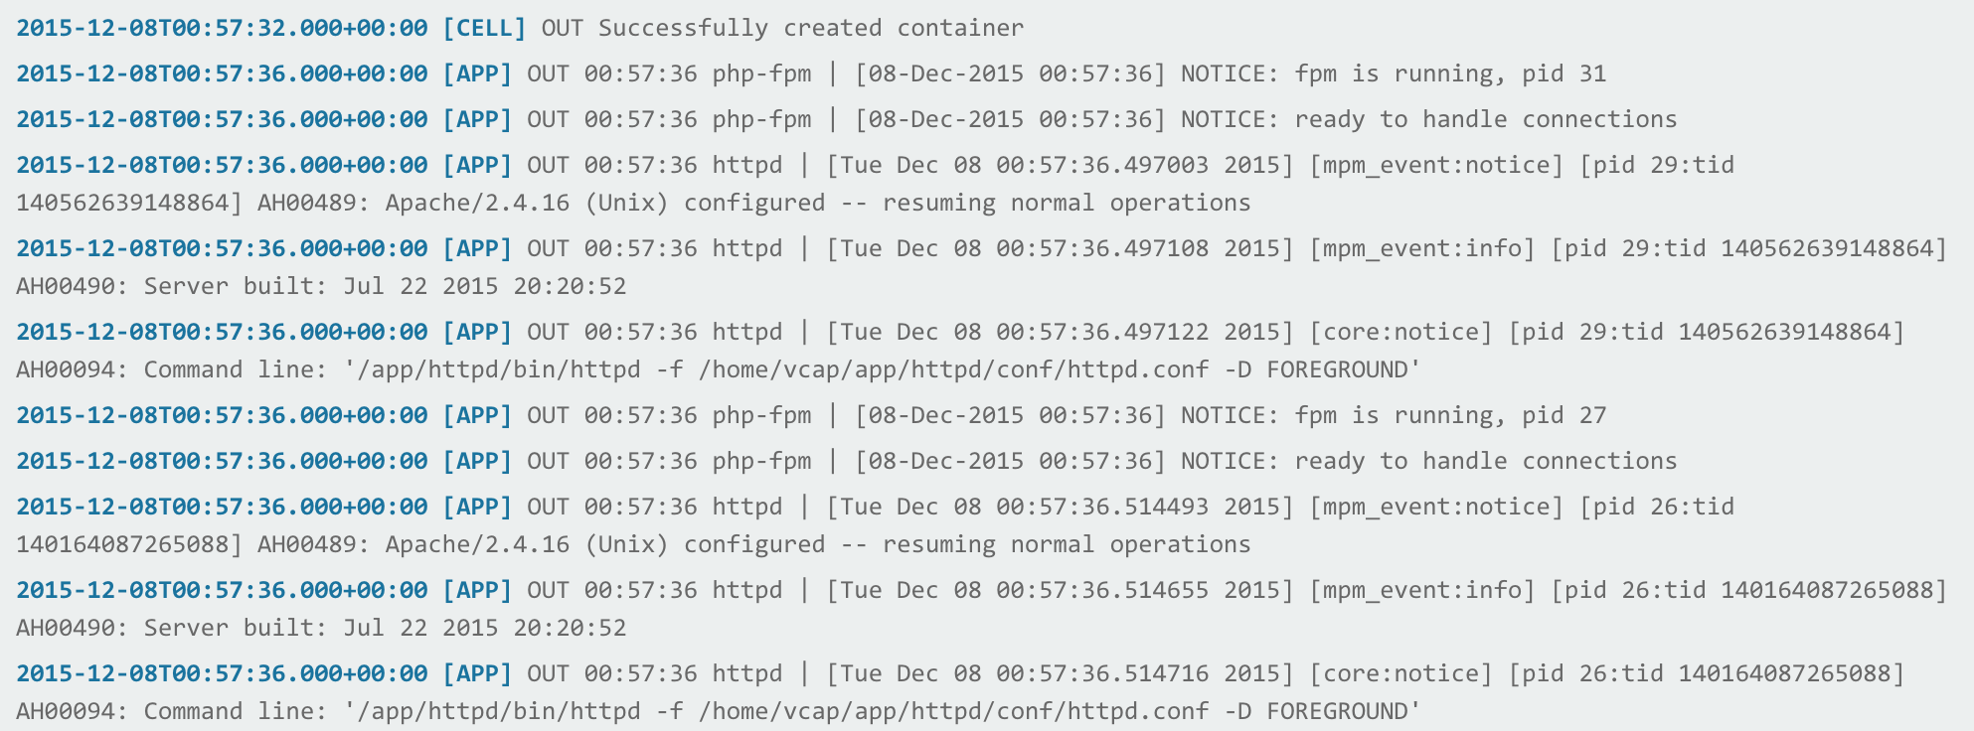
Viewing App Logs Using Apps Manager
In Apps Manager, select your app, then select Logs

Slide 35
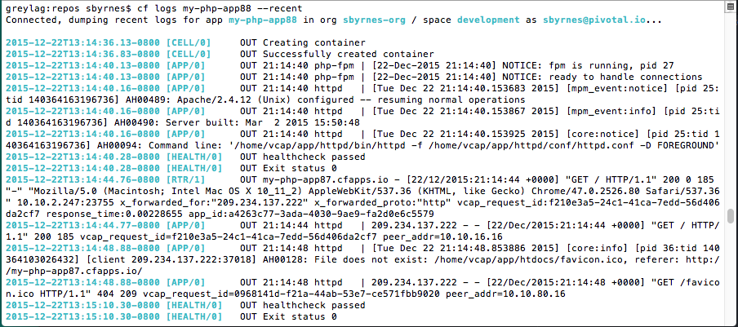
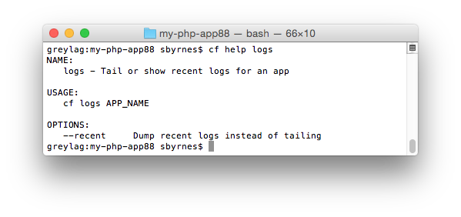
Viewing Logs For an App Using the cf CLI
Use “cf logs <app_name> --recent” to see recent logs
Use “cf logs <app_name>” to tail application logs

Slide 36
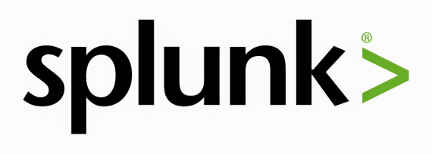
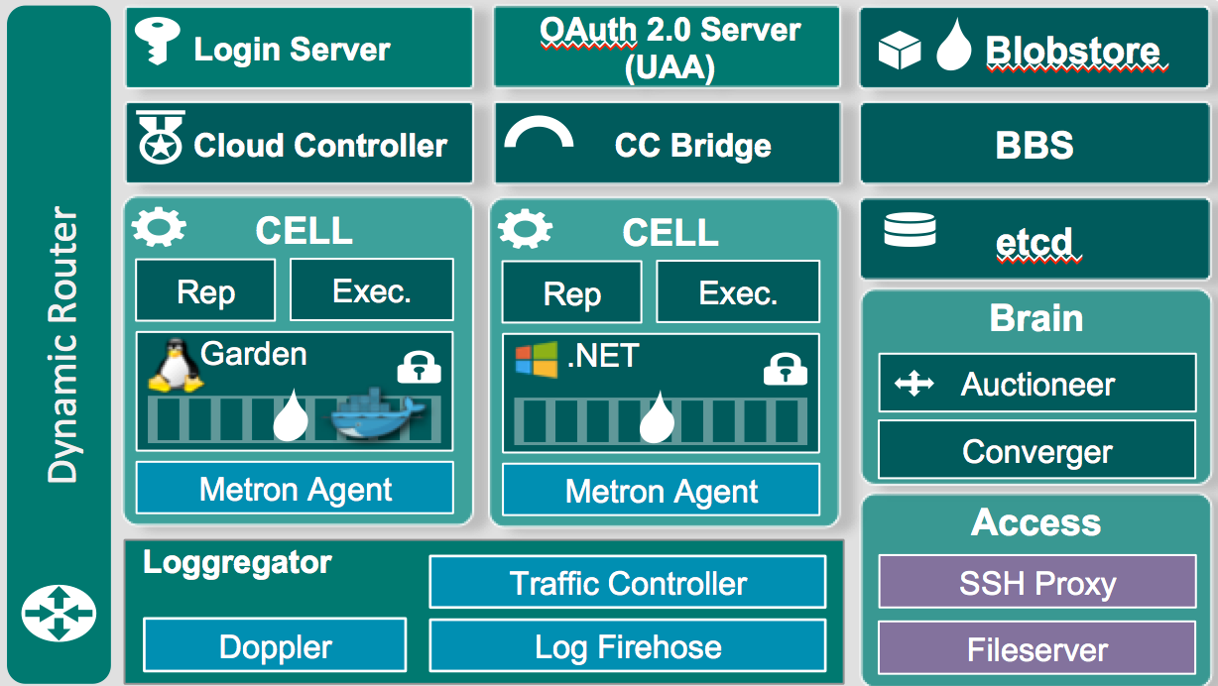
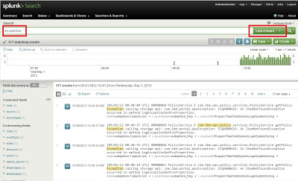
Stream application logs
Notes:
Need to install a plugin so Splunk can read CF logs properly
Note this isnt showing a full Splunk Arch

Slide 37
Loggregator helps us with
Debugging applications
Application insights
Monitoring system and application health
Exporting metrics into visualization tools
http://docs.pivotal.io/pivotalcf/1-9/loggregator/architecture.html
Notes:
Examples of monitoring system and application health:
App/platform latency
Platform memory statistics (allocated bytes, duration of last garbage collection)
Platform authentication failures

Slide 38
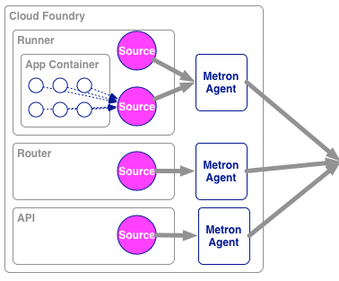
Behind the Scenes – Loggregator architecture
Syslog Drains
Cell
Nozzles
Traffic
Controller(s)
Datadog
Doppler
Server(s)
Open TSDB
Firehose
Cloud Controller
http://docs.pivotal.io/pivotalcf/1-9/loggregator/architecture.html

Slide 39
cf logs- Behind the Scenes
A component of the Loggregator system called the Traffic Controller receives and responds to requests for logs and metrics
Cloud Foundry
Elastic Runtime
Router
Loggregator Traffic Controller
cf logs MyApp

Slide 40
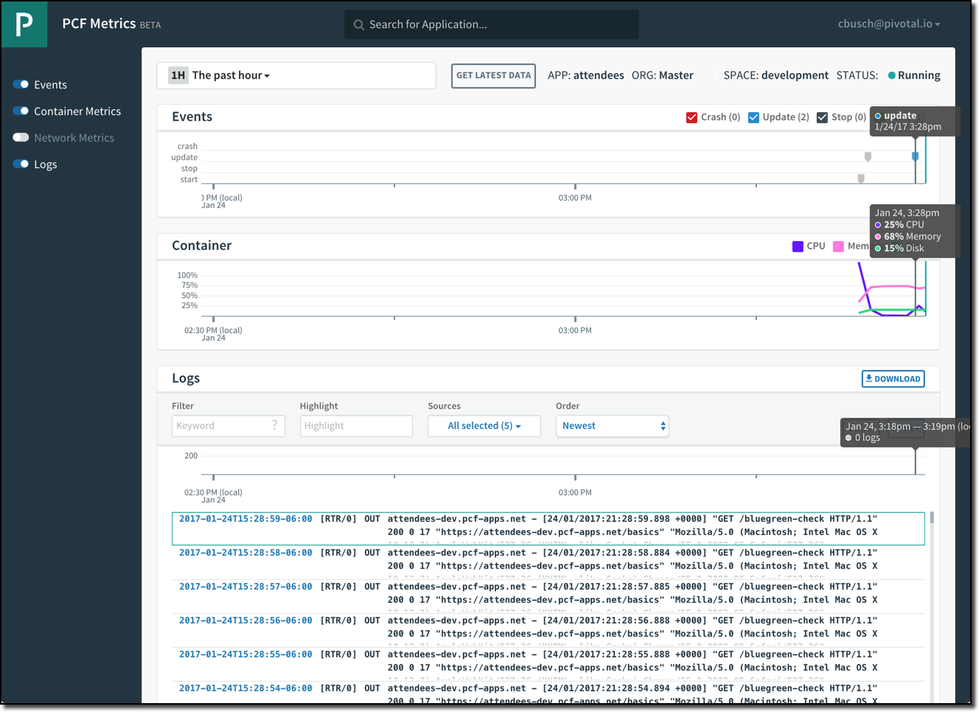
PCF Metrics
Application events
Container metrics
Application logs

Slide 41
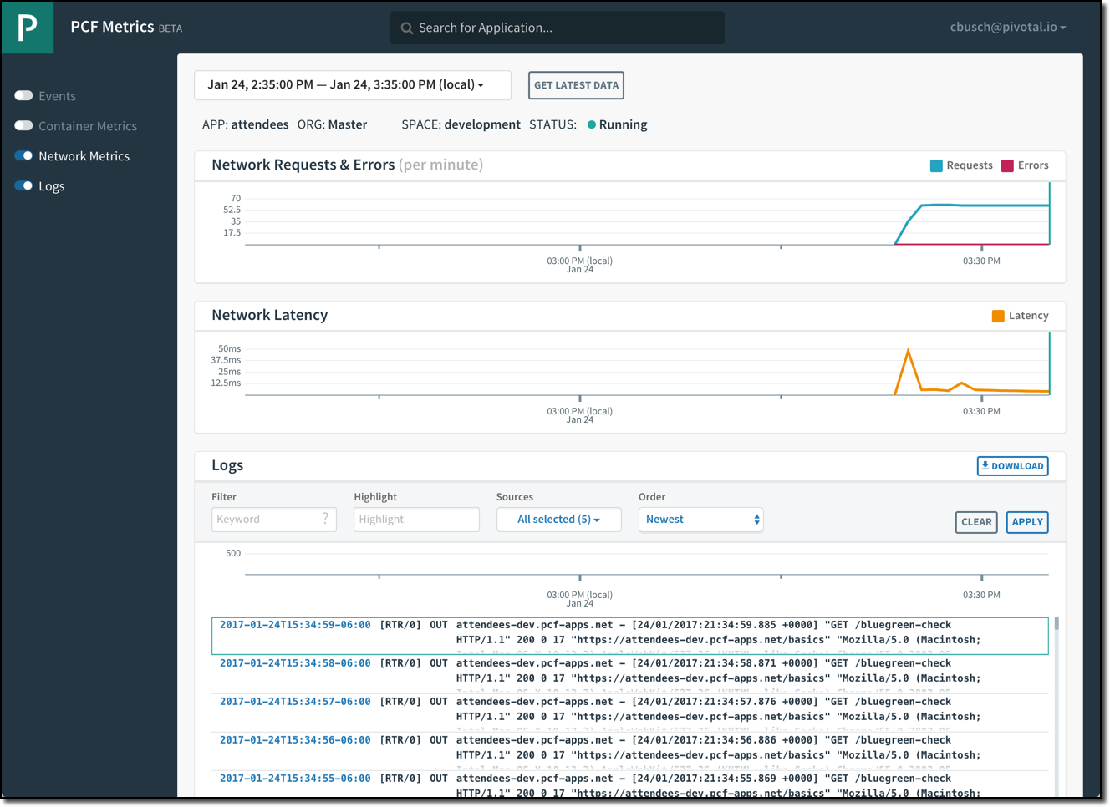
PCF Metrics
Networking metrics
Application logs

Slide 42
Application Performance Monitoring
PCF Metrics provides a real-time application monitoring dashboard
3rd Party Tiles provide in-depth monitoring of applications running on PCF via an embedded agent bundled with applications that are deployed using Buildpacks
New Relic
AppDynamics
Dynatrace

Slide 44
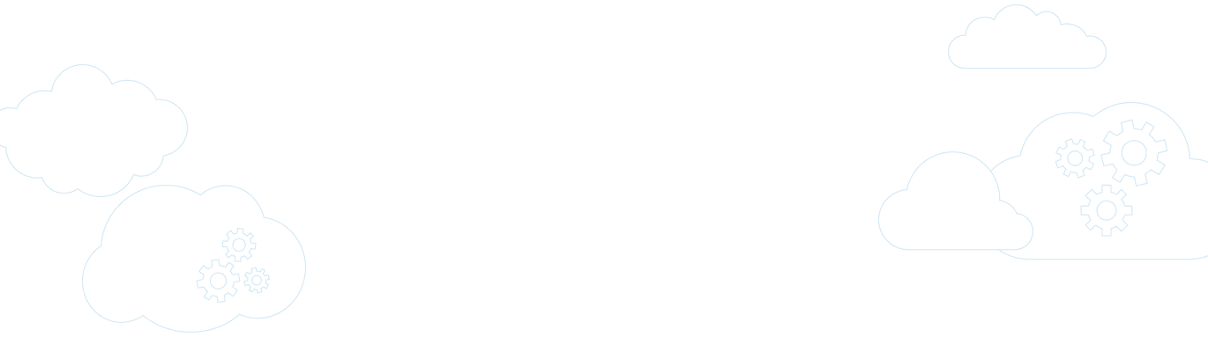

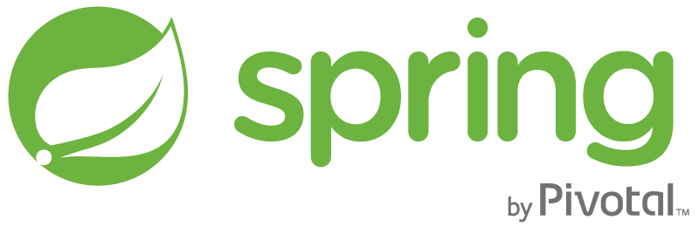
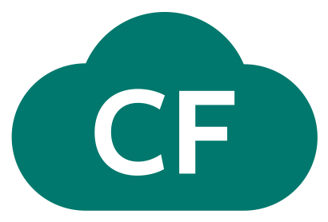
Pivotal Cloud Foundry
A complete framework for delivering software rapidly, consistently and reliably at scale.
Language frameworks designed for microservice architectures with components for service discovery, metrics, circuit breakers and more.
Application Framework
Application container runtime with production-ready backing services, automated build pipeline, routing, health management and logging.
Platform Runtime
Pivotal
Cloud Foundry
API-based infrastructure provisioning that delivers bit-for-bit, consistent, self-healing deployments across private and public cloud.
Infrastructure Automation
Pivotal
Cloud Foundry
Notes:
Infrastructure automation, it sits on top of any iaas, As a developer, you have zero concern about infrastructure, azure, aws, openstack. It delivers bit-for-bit, self healing deployments.
It gives you elastic runtime for you to run your application in a rapid, consistent, scalable, reliable manner
with production-ready backing services, automated build pipeline, routing, health management and logging.
it provides application framework for you to leverage. They are designed for microservice architectures with components for service discovery, metrics, circuit breakers etc.
Your job is to create stateless services that compliant with the 12 factor apps design principles.

Slide 45
Pivotal CF Architecture
Login Server
OAuth 2.0 Server (UAA)
Blobstore
Ops Manager UI
Cloud Controller
CC Bridge
BBS
Ops Manager Director
Operations Manager
CELL
CELL
etcd
Service Broker
Rep
Exec.
Rep
Exec.
Dynamic Router
Brain
Service Nodes
HA Load Balancer
Garden
.NET
Auctioneer
Service
Converger
Metron Agent
Metron Agent
Service Broker
Access
Loggregator
Service Nodes
Traffic Controller
SSH Proxy
Service
Doppler
Log Firehose
Fileserver
BOSH
Azure
Notes:
(Software is hard.) Developers, rejoice! All you need is I to write an app and push it. The whole point of Cloud Foundry is really to make your life as the developer exceedingly simple. But we know that in general, writing software is hard and so we had to take that hard and put it somewhere and we put it inside of Cloud Foundry so that you as a developer don’t have to worry about it. But so because we place that hard somewhere, we got this complicated beast. It does a pretty good job in doing the right things so developers have the faith not have to worry about any infrastructure.
The pivotal cloud foundary architecture is quite large and can be overwelming. Everybox here is a VM including bosh here.
It is a Microservice design. It has over 20 VMs . While each VM
it has ~20 VMs in addition to the existing three VMs: nats, Bosh light, ops manager. Now there is Router vm, blog store, oauth, uaa, database They all do something. They all do one thing and they do it very well. There is not much dicisions to make. It is kind of brutal force, very very effience. All of these sit on top of iaas, and bosh is managing all these.
Of course it is infrastructure unaware and iis it doesn't matter what your underlying infrastructural is, it could be ____aws,___vmware VSphere, it walks consistently across the different infrastructures. So you are experienced, when you are running Cloud Foundry on a __particular provider__________________ across the others.
And the Elastic Runtime Architecture is quite large and certainly I don’t expect you to understand all of it and so we’re not gonna go into a whole lot of detail only just kind of broad strokes here. But it’s easiest if we break it down into sub systems so were run through all of these. And then we’ll go through some key sequences to help us understand how these all comes together. And we’re gonna take an inside-out approach in a minute.
Diego, the first sub system within Elastic Runtime. It’s a scheduler. It’s responsible for scheduling tasks and long processeses.
A diego Task is an application that’s guaranteed to run at most once. That’s not something that we expose via the CF and CLI today, but we do use it within the platform, within the Pivotal Cloud Foundry. A good example of that is staging an application. So despite how many instances you have of a web app for instance, it only needs to be stage one time.
A Long-running Process on the other hand is typically, represented as a web app and you can have many instances of the long running processes.
The tasks and long-running processes are ran within a Container. And that container is imitable, just like we‘ve been talking about imitable infrastructure, once that container gets created it’s not going to change. There’s not gonna be changes made to it. And your applications are running safely within that, gives you that isolation in terms of CPU memory and disk.
And that allows you to have really nice application density on an operating system. In Pivotal Cloud Foundry’s case, that would be a cell. Pivotal Cloud Foundry has a pool of cells. Many, many VMs are of types cell and your application instances gets distributed across cells.
So what manages all of these Containers. Well, something known as Garden. And Garden is an interface with many different back-ends. And the reason that as many different back-ends is that so that it can support many different types of platforms.
For example, It has a Linux backend and a Windows backend. So you can run windows based applications and applications that can run on Linux as well. And it all has the same interface.
Rep is a part of process that’s running on the cell as well and it represents the cell and the bulletin board system, which we will talk about in a moment.
But also an Auction. An Auction is just like it sounds, it’s essentially held to bid on executing a task or long running process.
The Executor is the sub process of the Rep and one of its responsible for .. is really kind of understanding with what’s going on with that cell in terms of half container allocations. So it doesn’t have enough memory to allocate another container to this given cell. If it doesn’t it wouldn’t participate in an auction for instance.
Additionally, the Executor does for Loggs on to Metron which subsequently _______ them to Loggreators. So Loggreator, excuse me Metron is of course also living in the cell and so you begin to see the beginnings of a micro service based architecture here.
Bulletin Board System (BBS) is the API to the Diego database. It understands what's going on in terms of tasks and long-running processes and it persists all of these information into the etcd.
The Brain is really responsible for holding the Auction and it does that through sub process known as the Auctioneer. The Converger is also important but I'm going to save the conversation on that until we talk about that in the high availability section.
Next we have the Loggregator. Loggregator is all about Logs and we had talked about how Metron is living on the cell and it passes logging information onto the Loggregator subsystem.
The subsystem is made up of a lot of different components one of which is called Doppler. So one of the capabilities of the system is the ability to create what are known as App Syslog Drains, and what that allows you to do is drain all of your logs to a third-party log management system such as Splunk or Papertrail.
And then of course there's also the Traffic Controller. The Traffic Controller is another component but it's responsible for essentially handling requests such as CF logs. You guys will do that in the lab, We’ll do CF log statement and actually get to see all the logs from your application and various parts of the platform as it relates to your application.
Additionally there are other ways to plug in to the Loggregator system. We've exposed what's known as the Firehose which is a websocket endpoint, that exposes a lot of things and that's why it's called the Firehose, the app logs, container metrics and elastic runtime component metrics.
And really... what we're seeing folks do with this is, is pipe it into what are known as Nozzles. You to create a Nozzle and then transform it into whatever format you need it to. So for instance the Datadog Nozzle, you could create a nice visualization and Datadog to understand what's going on with your Pivotal Clou Foundry Instance.
The Cloud Controller Cloud Controller is very important part of the system. It exposes the API for using and managing the Elastic Runtime. The _____________ responding to the push request. It allows you to deploy your applications, and overall manage the system.
The Cloud Controller persists a lot of its information and what's known as a Cloud Controller Database. This has information about your Orgs, your Spaces and your App data. App data meaning, your application name, your memory, any environment variables you might set, those types of things.
The Blob Store is also important piece, so when you do an upload you actually save the the application artifact to the Blob Store but when you also go through staging and create the droplet that also gets saved to the to the Blob Store, and it's really just kind of a way to optimize the system so that those tasks don't have to be done over and over again.
When we talk about the Cloud Controller Bridges, will become more apparent the next slide, but really what the Cloud Controller Bridge is all about, is really translating an application specific domain into the more generic Diego language of tasks and long-running processes.
So let's talk a little bit about Routing. In this case, the Router is responsible for routing traffic to the appropriate component it's not much of a surprise. So for instance whatever your URL is, it's going to be able to map that to various application instances running on the given cells.

Slide 46
Elastic Runtime vs. BOSH
The Elastic Runtime
is about managing distributed
applications in containers
containers
BOSH/Ops Manager is about managing distributed software on VM clusters
VMs

Slide 47
Pushing an Application
Blobstore
DB
Service
credentials
Staging: Upload app bits and metadata
Stage
Cloud Controller
Service Broker Node(s)
Deploy
push app
+ app MD
Cloud Controller Bridge
BBS / etcd
Starting
Running
Managing application health
Router
CELL
Brain
DEA
DEA
Auctioneer
+
=
Task
LRP
Runtime
Notes:
Change to the version that works

Slide 48
Staging/starting an Application
Staging Request
Task
Blobstore
Cloud Controller
Cloud Controller Bridge
BBS / etcd
Service
credentials
CELL Auction
Brain
DB
Auctioneer
Router
CELL
System
Buildpacks
Detect
Compile
Upload
No
Yes
Python
+
=
Java
Runtime

Slide 49
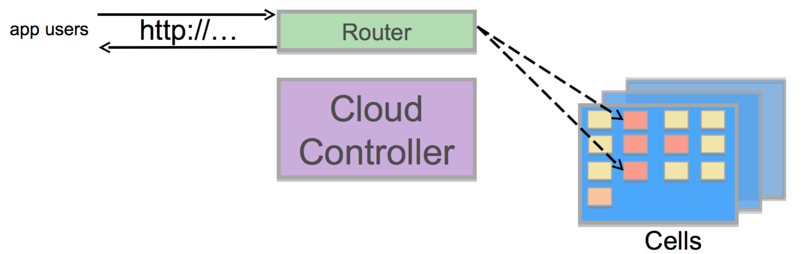
Running an Application
Blobstore
Cloud Controller
Cloud Controller Bridge
BBS / etcd
Service
credentials
CELL Auction
Brain
DB
Auctioneer
System
Buildpacks
Detect
Compile
Upload
No
Yes
Python
+
=
Java
Runtime

Slide 50
CF SCALE Demo
Notes:
Push an App, show the logs

Slide 51
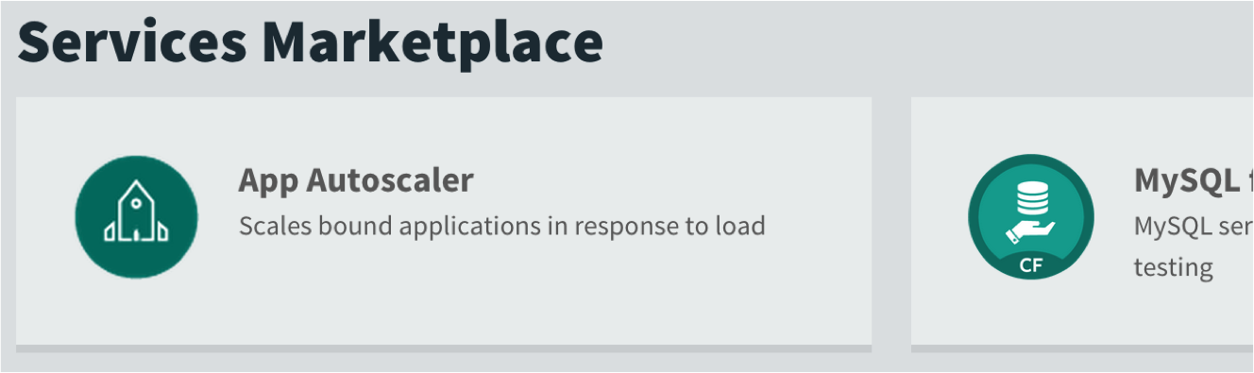
App Autoscaler
CPU usage or time-based schedule can be used to scale application instances
It is a service in the marketplace
Notes:
Discuss the app autoscaler

Slide 52

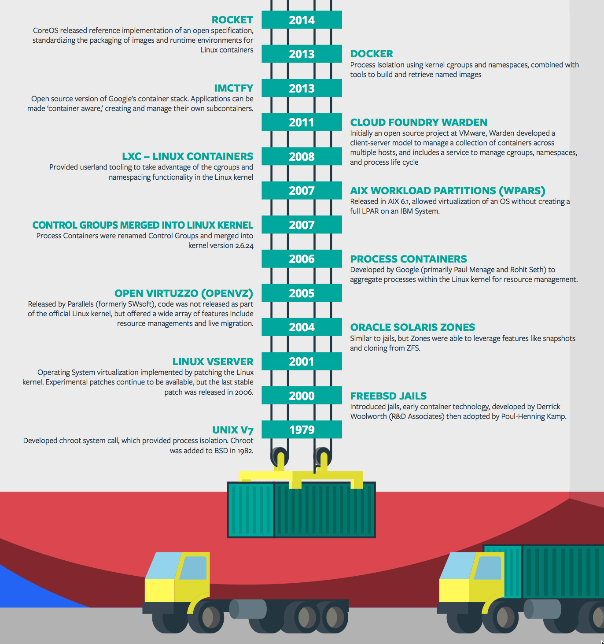
Containers - History
CONTAINERS!!!!
Containers are not new
CF has used containers since it’s inception
CF supports multiple container technologies as first class citizens including Docker, Warden, Garden and runC
Notes:
Linux Cgroups and Namespaces
History of Docker
- 2006 Google to use containers they built cgroups and namespaces and pushed it to the Linux kernel
- cgroups and namespaces give you isolation (Resource Isolation and Namespace isolation)
- dotCloud and LXC fragmentation
- libcontainer created to address application portability and standard API across linux distros BUT controlled by Docker
- Open Container Project (Docker/dockerfile, CoreOS/appc). Standardiized on runC
- Standardizing the file format (dockerfile + appc = filesystem)
- Standardizing the runtime (libcontainer = runC)
- Container (Isolation + Files/metadata + Processes)

Slide 53
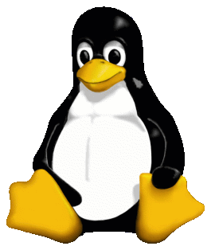


Container Isolation
CPU
resource isolation
namespace isolation
cgroups
process D
process F
process F
process E
process A
process E
process B
process D
process C
A Linux kernel feature that limits, accounts for, and isolates the resource usage of a collection of processes
tenant 1
tenant 2
tenant 3
Notes:
Cgroups - A Linux kernel feature that limits, accounts for, and isolates the resource usage of a collection of processes
----- Meeting Notes (4/20/16 11:43) -----
Add on to extend a VM?

Slide 54
Container Isolation
PID
2
3
4
2
2
3
resource isolation
namespace isolation
PID namespace
process F
The PID namespace provides isolation for the allocation of process identifiers (PIDs), lists of processes and their details.
process A
process E
process B
process D
process C
tenant 1
tenant 2
tenant 3
Notes:
PID namespace - provides isolation for the allocation of process identifiers (PIDs), lists of processes and their details.

Slide 55
Customize the Container Experience
Buildpacks
Containers
Developer brings customized app
Developer brings customized app
Platform buildpacks provide standard runtime*
Developer brings runtime container image
Platform provides fixed OS container image
Developer brings container OS image
Platform provides fixed host OS Kernel
Platform provides fixed host OS Kernel
App container
* Devs may bring a custom buildpack

Slide 56
Pivotal Cloud Foundry
Operations

Slide 57

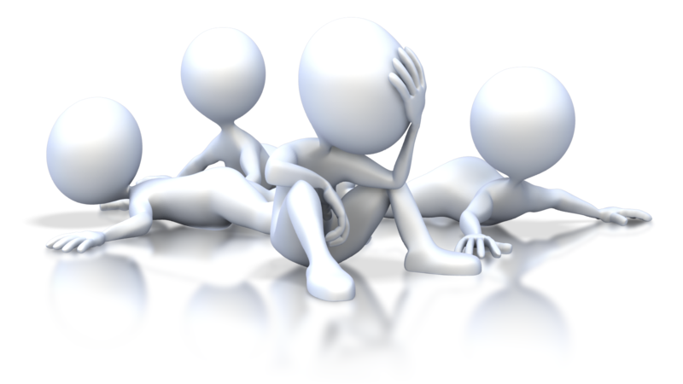
Pivotal CF operations
Developer
Operator

Slide 58










Install runtime and container
Deploy to dev
Install services (db,
messaging, hadoop, …)
Setup load-balancing, SSL termination and dynamic routing
Setup / config
High Availability
App Deployed
Setup APM
Setup log streaming

Slide 59

Blue-green deployment
Restart server
Upgrade app
Deploy to Test
Create service
Deploy to dev
Change JDK
Redeploy
Scale Platform
Scale up
Bind service
Update app
Deploy to QA
Update app server
Unbind service
Change route
Promote to production
Escale memory
Check logs
Scale down
Delete App

Slide 60








The Pivotal CF Way
Pre-configured
Deploy to dev
Cloud
Controller
BBS
> cf push
Router
BRAIN
Access
App Deployed
Loggregator

Slide 61


Operators in the Cloud Native Platform Era

Slide 62












Install the platform
Setup High Availability
Pivotal CF
Install and manage services
Target multiple clouds
IaaS
Handle live upgrades and updates
Azure
Scale and
plan capacity

Slide 63

BOSH?

Slide 64
Bosh Haiku
Here are my servers
Go make them a cloud foundry
I do not care how
Notes:
a Japanese poem of seventeen syllables, in three lines of five, seven, and five, traditionally evoking images of the natural world.

Slide 65


Click to install
No downtime updates
Explore install logs
Pivotal Elastic Runtime
MYSQL for
Pivotal CF
App Autoscaling
Pivotal Ops Metrics
RabbitMQ for
Pivotal CF
Riak CS for
Pivotal CF
Click to scale the platform
Pivotal Redis
Spring Cloud Services
CloudBees Jenkins for Pivotal CF
Built-in High Availability
Cassandra for Pivotal CF
Pivotal HD for Pivotal CF
GitLab for
Pivotal CF
Built-in Platform Monitoring
Elastic Search for Pivotal CF
Mobile Services for Pivotal CF
Spring Cloud
Data Flow
BOSH Director
BOSH Agent
Integrated services
IaaS
Azure

Slide 66
D e m o
Notes:
How to scale the platform

Slide 67
Multi-tenancy
Overview

Slide 68


Orgs, Spaces, Users & Quotas

Slide 69
Organizations
Logical division within a Pivotal CF install / Foundation.
Each organization has its own users and assigned quota
User permissions / roles are specified per space within an organization
Sub-divided into Spaces

Slide 70

Quotas & Plans
Different quota limits (e.g. “small”, “enterprise”, “default”, “runaway”) can be assigned per Organization
Quota defines
Total Memory
Total # of Services
Total # of Routes

Slide 71

Spaces
Logical sub-division within an organization
Users authorized at an organization level can have different roles per space
Services and Applications are created / specified per Space
Same Service can have different meanings per space
Spaces can be assigned quotas

Slide 72

Notes:
This looks a lot like Splunk
Kubernetes doesn’t have built-in logging and analytics capabilities
D

Slide 73
Containers and Scaling
Overview
Notes:
So how many people in here have heard of BOSH?
BOSH is the cloud foundry platform orchestration engine
This is the same BOSH used in open source cloud foundry, making Pivotal, the closest platform to the original CF!
Then you also know how tedious it can be to manage orchestration via manifest files, hence we created Ops Manager to make an easy way to work with it.
http://bosh.io/docs/about.html
https://bosh.io/docs/bosh-components.html

Slide 74
Container Isolation
shared resources
resource isolation
kernel
namespace isolation
Cell
process F
process A
process E
process B
process D
process C
tenant 1
tenant 2
tenant 3
Notes:
----- Meeting Notes (2/10/16 13:49) -----
modify to represent the cell, and change tenants to containers

Slide 75
Four Levels of HA
Built In!
Notes:
So how many people in here have heard of BOSH?
BOSH is the cloud foundry platform orchestration engine
This is the same BOSH used in open source cloud foundry, making Pivotal, the closest platform to the original CF!
Then you also know how tedious it can be to manage orchestration via manifest files, hence we created Ops Manager to make an easy way to work with it.
http://bosh.io/docs/about.html
https://bosh.io/docs/bosh-components.html

Slide 76
Cloud Foundry: An Application-centric Platform
Mobile Services
Centralized Log Management
Networking
& Load Balancing
Auto-Scaling
APM & Tracing
APPLICATION
Health management
Full Stack CI/CD platform
Notes:
Your Application is the Center of the universe!
Cloud Foundry takes care of the rest. Everything you need to deliver software is builit into this platform such as…. It changes the way applications and services are deployed and run by reducing the develop to deployment cycle time. And Devops culture enables the overall ownership there for allows teams to do what’s best for the applications, and therefore what’s best for the business, so not only your application is more robust, it can constantly adapts to changing environmental.
So Spring Boot/Cloud meant create apps fast – But Dev & Ops is asking Day2 questions -
How do you do logging, routing, apm, scaling, and lifecycle management of all these apps.
Enter CF Runtime
best in class container management
integrated agentless logging
with APM
auto scaling
Effortless runtime with minimum human operational overhead. We run 1000s of apps and 10,000s containers on PWS with 6 guys.
But we realized that stopping there wasn't enough

Slide 77
Cloud Foundry Haiku
Here is my source code
Run it on the cloud for me
I do not care how
Notes:
Best way to summarize cloud foundary experience for developers. Here is the famous CFH.
a Japanese poem of seventeen syllables, in three lines of five, seven, and five

Slide 78
Pivotal Cloud Foundry
Platform Access
Ops Manager
Elastic Container Runtime
Service
Dynamic Router
Service
Logging / Metrics
Application
Access
BOSH - Automation Layer
Azure

Slide 79
Deploying Apps Shouldn’t Be Painful
Traditional
Create a VM
Install JDK
Install Tomcat
Deploy Application
Configure Load Balancer
Configure DNS
Configure Firewall
Configure Monitoring
Configure Logging
Pivotal Cloud Foundry
cf push
Notes:
Discuss the traditional challenges associated with deployments and how PCF automates many of the steps. The team is not spending time writing and maintaining Infrastructure as code systems (i.e. puppet, chef, etc). This basic functionality is baked into the platform.

Slide 80
CF PUSH Demo
Notes:
Push an App, show the logs

Slide 81
Service Broker
Flexible, RESTful API
Allows Service Authors to provide self-provisioning Services to developers
Cloud Controller
Create
Service Broker
Service Nodes
Bind
Connect
CELL
Apps

Slide 82

Pivotal Cloud Foundry Services
Operated ‘as a Service’
Configured and integrated to enable push button deployment
Full lifecycle management - software updates and patching
Bind to apps through an easy-to-use interface
Common view into access control and audit trails across a breadth of services
EASY
Notes:
In many organizations, provisioning of data and messaging services for applications can take weeks, if not months because of the number of teams, administrators and exchange of credentials involved. We are striving to address this problem by providing a common model for services deployment via Pivotal Cloud Foundry that developers can easily find and their applications bind to – and scale those services as needed.
PCF Services allow administrators to provide pre-defined database and middleware services, and this gives developers the ability to rapidly deploy a software product from a menu of options without the typical slow and manual provisioning process. This is also done in a consistent and supportable way. PCF Services are managed and operated ‘as a Service,’ and this means they are automatically configured upon request. The provisioning process also incorporates full lifecycle management support, like software updates and patching.
This automation removes the overhead from developers, who are often saddled with service configuration responsibility. It makes administrators’ lives easier and addresses security risks by standardizing how services are configured and used.

Slide 83
Platform Logging
Notes:
Need to install a plugin so Splunk can read CF logs properly
Note this isnt showing a full Splunk Arch

Slide 84

Platform Monitoring
Pivotal Metrics allows developers to understand the health and performance of their apps by providing a near real-time view of critical data.
3rd Party provide in-depth monitoring of applications running on PCF via an embedded agent
-New Relic
-AppDynamics
-Dynatrace
Notes:
Zipkin tracing (default in PCF 1.9) gather timing data needed to troubleshoot latency problems in microservice architectures.
Applications are instrumented to report timing data to Zipkin. The Zipkin UI also presents a Dependency diagram showing how many traced requests went through each application. If you are troubleshooting latency problems or errors, you can filter or sort all traces based on the application, length of trace, annotation, or timestamp. Once you select a trace, you can see the percentage of the total trace time each span takes which allows you to identify the problem applications.

Slide 85
Syslog Drains
Syslog drains allow data related to an application to be sent to third-party log managers
The data from the Doppler Servers is sent to the Syslog drain
The Traffic Controller is not used
Syslog Drains
Cell
Traffic
Controller(s)
Doppler
Server(s)
Cloud Controller
http://docs.pivotal.io/pivotalcf/1-9/loggregator/architecture.html

Slide 86
Firehose and Nozzles
Traffic Controllers have a Firehose endpoint
The Firehose streams all the event data coming from an Elastic Runtime deployment
Includes application logs, HTTP events and container metrics
Includes metrics from all Elastic Runtime components
Does not include Elastic Runtime component logs
Operators can deploy nozzles to the Firehose endpoint, which listen for a subset of data from the Firehose
Cell
Nozzles
Datadog
Traffic
Controller(s)
Doppler
Server(s)
Open TSDB
Firehose
Cloud Controller
http://docs.pivotal.io/pivotalcf/1-9/loggregator/architecture.html
Notes:
Where do elastic runtime component logs go?

Slide 87

Platform syslog
Elastic Runtime can send system logs to an external syslog server
Configure this in the System Logging tab

Slide 88
PCF JMX Bridge (Ops Metrics)
Collects and exposes system data from PCF components via a JMX endpoint (Cloud Controller, Router, Diego, VMs, etc)
Composed of the following VMs:
JMX provider
VM that governs compilation
Nozzle for the Loggregator Firehose

Slide 89

Viewing the Events for your App
In Apps Manager, select your app, then select Events
Or in the cf CLI cf events <my-app-name>

Slide 90
Canary-Style Deployment: Implications
Elastic Runtime can be upgraded to new versions with no application downtime
“Apply changes” does not mean “wait for it to finish”
You will have limited ability to deploy applications during Elastic Runtime upgrades
Installing or modifying other tiles does not affect the Elastic Runtime
For the ops team- upgrade the system during working hours!
Notes:
All info in this section comes from http://docs.cloudfoundry.com/docs/using/deploying-apps/manifest.html#attributes

Slide 91
Loggregator - The Voice of the System
Provides logging and metrics for the Elastic Runtime
A modern approach to logging that emphasizes:
Support for ephemeral, container-based applications
Productivity by streaming logs and metrics to operators and developers (no log shipping)
Accessibility and visibility into your applications and the platform
Seamless integration with modern log management services (e.g. Splunk, LogStash)

